Slide 1

Sign Language recognition using cNn and opencv
Presented By:-
Rohit (05611502819)
Mohit Kumar Sharma (06111502819)
Hemant Kumar (06311502819)
Guided By:-
Dr. Preeti Nagarath, Dr. Rachna Jain,
Dr. Ashish Kumar

Slide 2
CONTENTS
Introduction
Problem Statement
Training the Model
Description of the Model
Testing the Model
Conclusion
References

Slide 3
INTRODUCTION
The project focuses on translating American Sign Language into text using CNN model and OpenCV library of python. The training and testing of the model will done by classical convolutional neural network and then for real time application OpenCV will be used to detect the hand gesture and then the final prediction will be made by the CNN model.

Slide 4
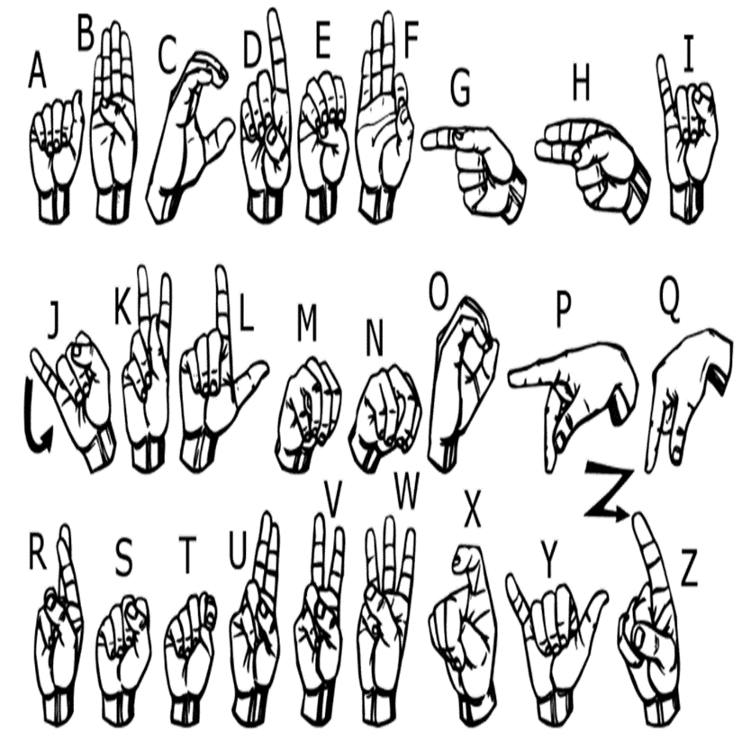
PROBLEM STATEMENT
For interaction between normal people and D&M people a language barrier is created as sign language structure which is different from normal text. So, they depend on vision-based communication for interaction. If there is a common interface that converts the sign language to text, the gestures can be easily understood by the other people.
Fig. Sign Language Dataset

Slide 5
Goals
Building a classification model using CNN to classify the sign language into alphabet
Detecting the hand gesture
Making real time prediction using OpenCV
Convert it into text for further use.

Slide 6
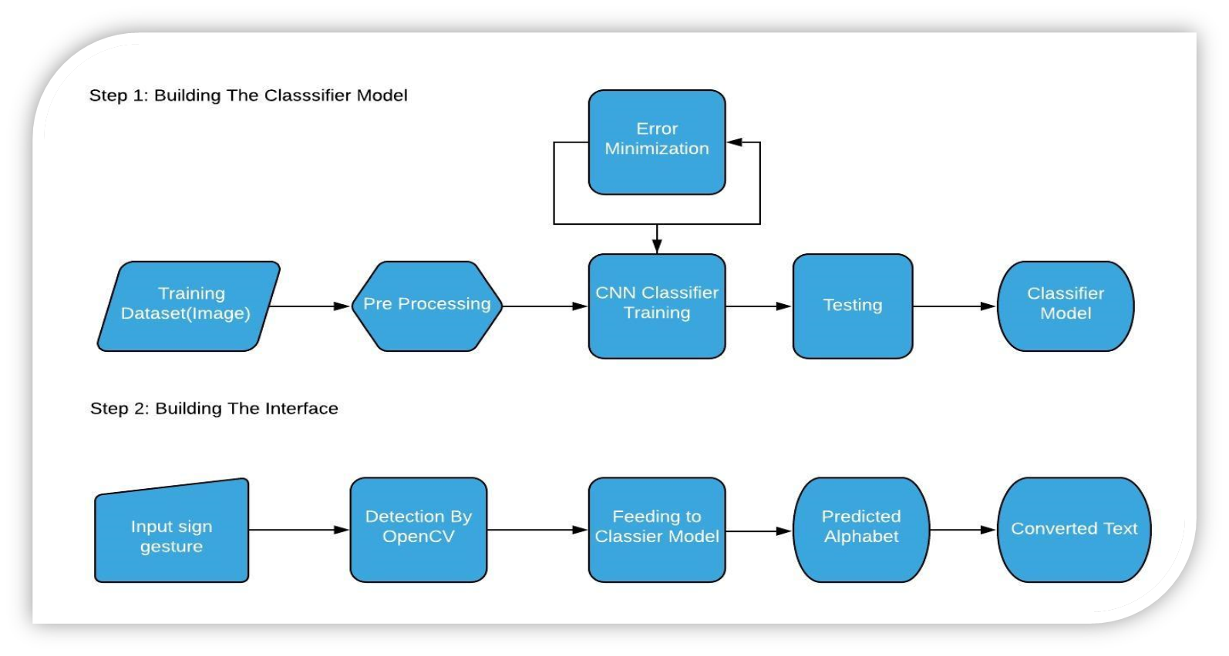
Work Plan

Slide 7
Training the CNN Model
In the second step the CNN model is trained with the images which are classified to 25 classes (A-Z) previously.
The CNN model contains total 9 layers. First two are two convolution layers followed by 1 maxpool layer. Then there is one flatten layer which is followed by two fully connected layer(dense).

Slide 8
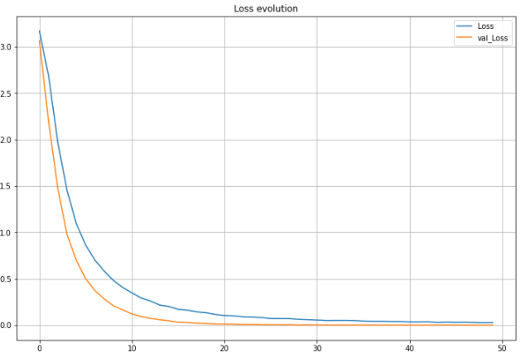
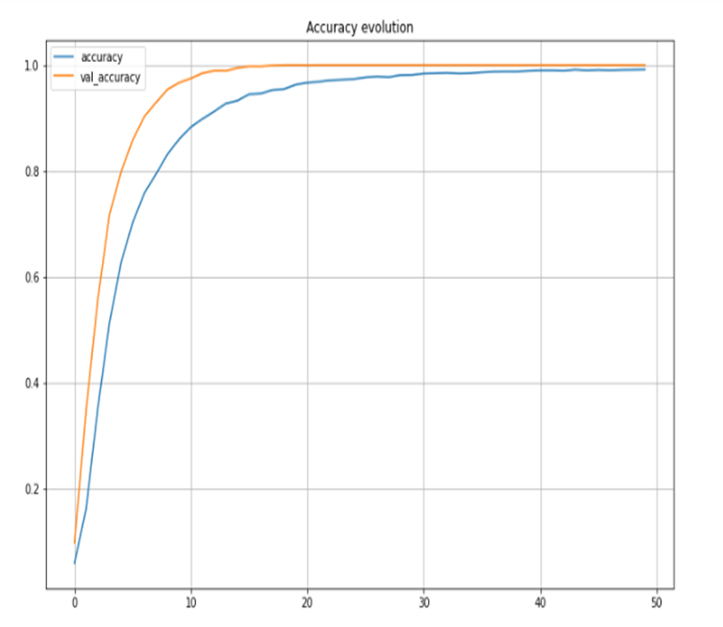
Loss and Accuracy

Slide 9
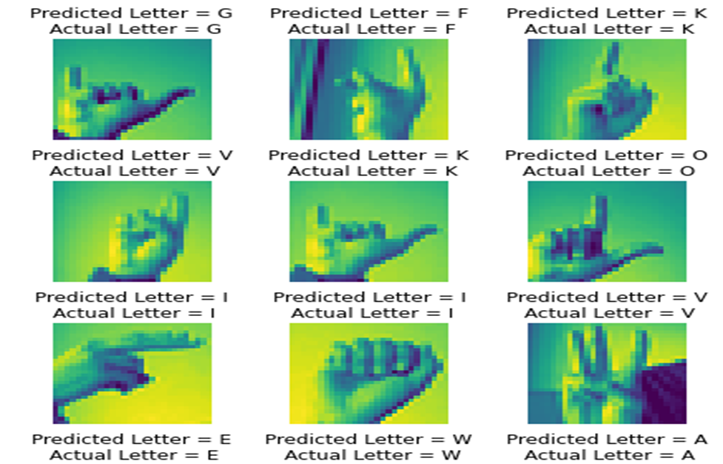
Predictions
Test accuracy is 97%
Predicted letters are almost same as the actual letters.

Slide 10
Description of the Model
The model gives almost 97% accuracy while predicting. With maximum value of accuracy, our model should be able to recognize the alphabet but in the use of OpenCV the system is becoming real time, but prediction level is less. It can't print every detected character in console and screen correctly.
So, we create our own dataset of 100 images of each letter for training purpose and 50 for testing purpose and train these images to make our model useful in real time through an interface using OpenCV.

Slide 11
Preprocessing
The first task is to preprocess the image. In order to do so first a background of dark is pasted around all the images are converted to ‘RGB’ format to make the image channels similar.
Next , we apply our gaussian blur filter to our image which helps us extracting various features of our image. Finally, the images are transformed to similar dimension 300x300.

Slide 12

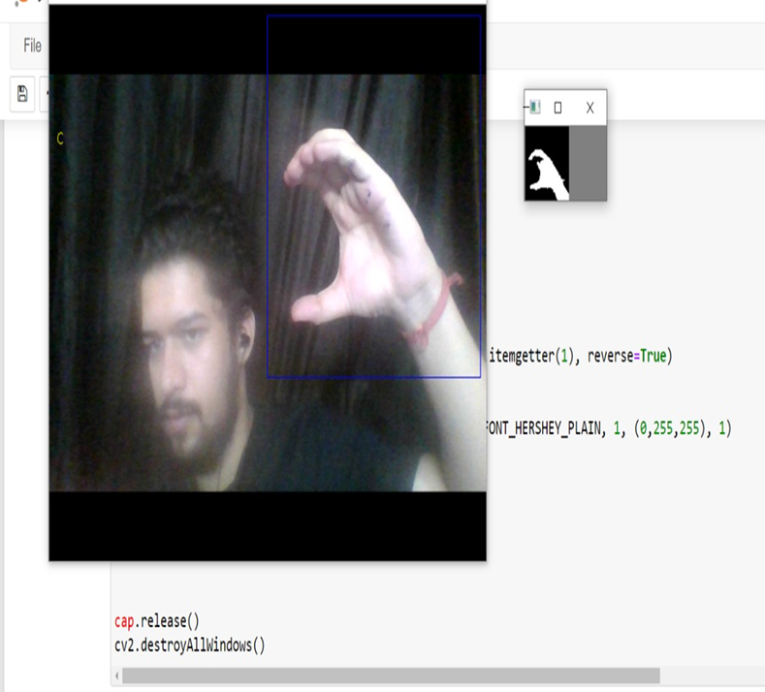
Making the Interface
This step is to make the interface that will interpret the sign language and will convert to text. This will be made using Open CV library of python. The image will be captured and will be made ready so that it can be fade to the CNN model and the output of the model will be displayed in the screen.
Fig. Testing the model

Slide 13

Conclusion
This system can be used in the medical, educational and many other fields. We will be very happy if the system comes in use of society and people. In the next versions we will try to make the system more accurate and stable than this version and will try to add other features like convert the text to some other language based on the choice of the user and converting the text to speech and we will try build an android version of the system

Slide 14

References
G. Kaur, “Multimodal Biometrics Feature Level Fusion for Iris and Hand Geometry Using Chaos-based Encryption Technique,” Proc. IEEE Int. Conf. Image Inf. Process., vol. 2019-Novem, pp. 304–309, 2019, doi: 10.1109/ICIIP47207.2019.8985690.
W. Tao, M. C. Leu, and Z. Yin, “American Sign Language alphabet recognition using Convolutional Neural Networks with multiview augmentation and inference fusion,” Eng. Appl. Artif. Intell., vol. 76, no. September, pp. 202–213, 2018, doi: 10.1016/j.engappai.2018.09.006.
G. A. Rao and P. V. V. Kishore, “Selfie sign language recognition with multiple features on adaboost multilabel multiclass classifier,” J. Eng. Sci. Technol., vol. 13, no. 8, pp. 2352–2368, 2018.
G. Suryanarayana and R. Dhuli, “Super-Resolution Image Reconstruction Using Dual-Mode Complex Diffusion-Based Shock Filter and Singular Value Decomposition,” Circuits, Syst. Signal Process., vol. 36, no. 8, pp. 3409–3425, 2017, doi: 10.1007/s00034-016-0470-9.
R. J. Hoffmeister and J. Paul Gee, “American sign language,” Discourse Process., vol. 6, no. 3, pp. 197–198, 1983, doi: 10.1080/01638538309544563.
V. Adewale and A. Olamiti, “Conversion of Sign Language To Text And Speech Using Machine Learning Techniques,” J. Res. Rev. Sci., vol. 5, no. 1, 2018, doi: 10.36108/jrrslasu/8102/50(0170).

